Slide 1
Customer Churn Analysis at Fit.ly
Data Analyst Professional Certification
Mahdi Dehlaghi
Objective:
Identify factors associated with customer churn.
Notes:
Introduce yourself and the project objective.

Slide 2
Business Problem
• Customer churn increased over the past two quarters.
• Customer retention is a key business priority.
• Analysis combines account, support and activity data.
• Goal: identify actionable insights to reduce churn.
Notes:
Explain the business problem and why churn matters.

Slide 3
Data Validation
Account
• 400 customers
• No duplicates
• Missing churn values documented
Support
• 918 tickets
• Dates converted
• Invalid channels standardized
Activity
• 445 events
• No duplicates
• Dates converted
Notes:
Describe the validation and cleaning process.

Slide 4
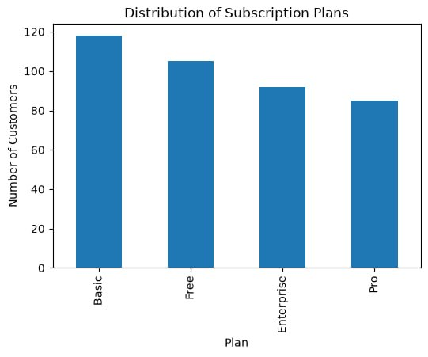
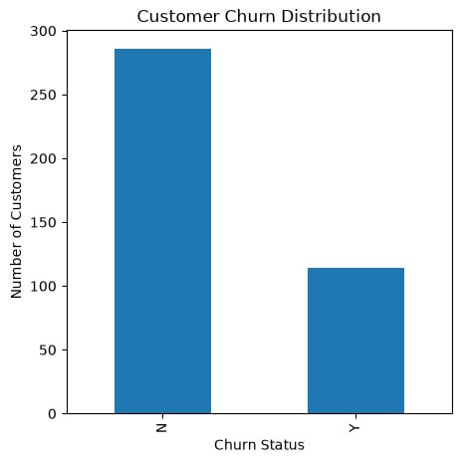
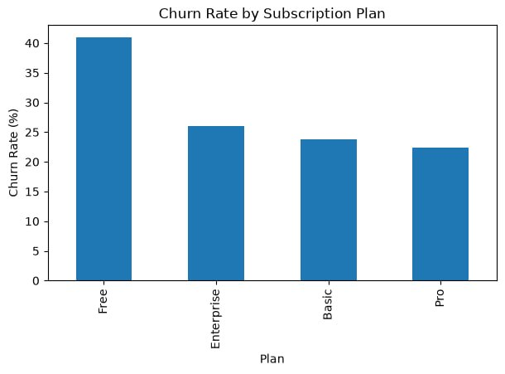
Exploratory Analysis
Notes:
Walk through the first three charts.

Slide 5
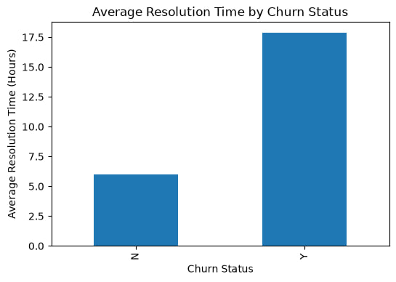
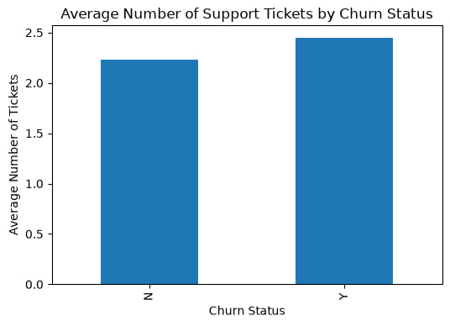
Customer Support Insights
Key finding:
Customers with longer resolution times were more likely to churn.
Notes:
Explain support-related findings using the charts.

Slide 6
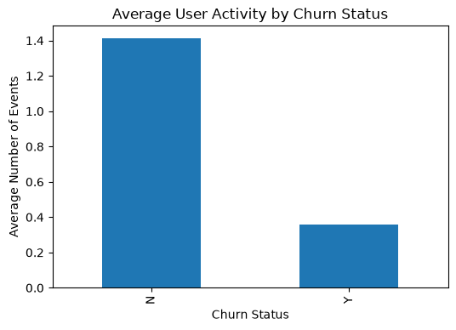
User Engagement & KPI
GRAPH 6 – Average User Activity
KPI: Customer Churn Rate
Current Value: 28.5%
Monitor monthly.
Notes:
Discuss user engagement and the recommended KPI.

Slide 7
Recommendations
1. Improve Free plan retention.
2. Reduce support resolution time.
3. Increase customer engagement.
4. Identify high-risk customers early.
Notes:
Present the four business recommendations.

Slide 8
Conclusion
• Free plan customers have the highest churn.
• Lower engagement and longer support resolution are strongly associated with churn.
• Monitoring churn monthly will help evaluate retention strategies.
Thank You!
Notes:
Summarize the findings and thank the audience.

